Slide 1



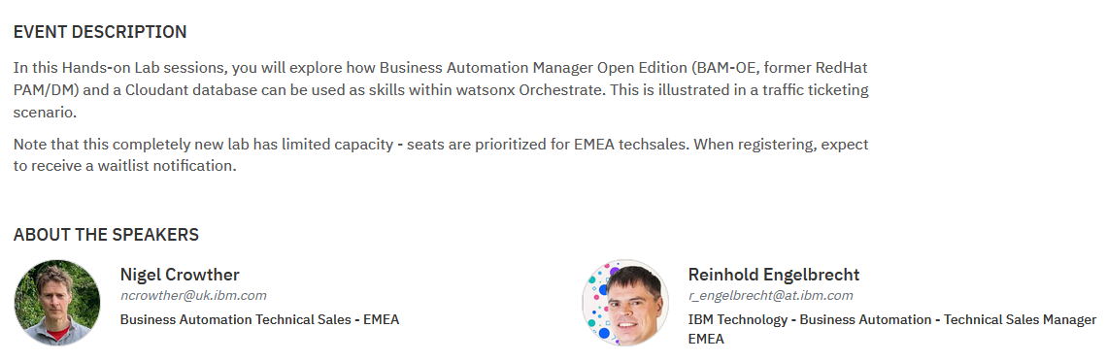
WxO with Open-Source Hands on Lab 16th Jan 2024 08:30-11:00 CET

Slide 2

Agenda
08:30 – 09:00 – Lab introduction
09:00 – 11:40 – Lab
11:40-12:00 - Q&A with product management.
12:00 Close
Integrating Wxo with Open-source HOL

Slide 3











IBM watsonx Orchestrate Architecture
Workflow
Process Mining
Decision Management
Robot Process Automation
CP4BA Capabilities
Hybrid-Natural Language
AI-based orchestration
Prebuilt skills
Open Capabilities
Skills Catalog
3rd Party Systems
OpenAPI
Open API
Integrating Wxo with Open-source HOL

Slide 4



What will be Integrated?
IBM’s Open-source Workflow and rules engine
https://www.ibm.com/products/business-automation-manager-open-editions
BAMOE
IBM’s version of CouchDb, an open-source NoSQL database
https://www.ibm.com/products/cloudant
Cloudant
Open-source user interface based on NodeJs
https://react.dev/
React
Integrating Wxo with Open-source HOL

Slide 5

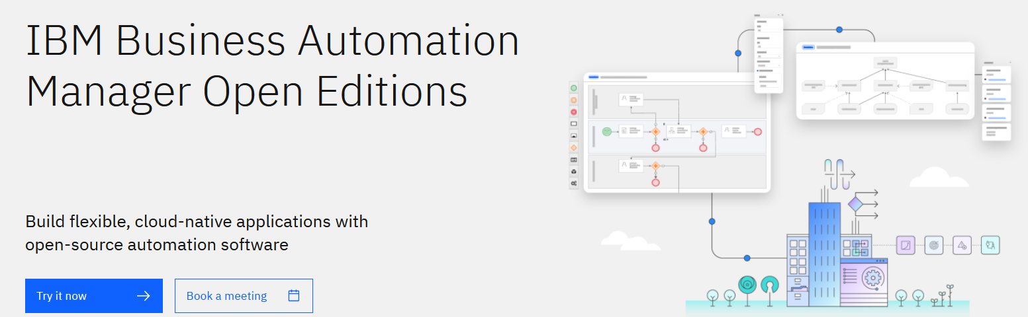








IBM’s Open-Source Business Automation Solution
Includes Decisions (DMN) and Process (BPMN)
https://www.ibm.com/products/business-automation-manager-open-editions
Process Automation
Decision Mgmt (DMN)
RPA (Limited license)
Case Management
Rules Automation (DRL)
Business Activity Monitoring
Complex Event Processing (DRL)
IBM Business Automation Manager Open Edition
Integrating Wxo with Open-source HOL

Slide 6
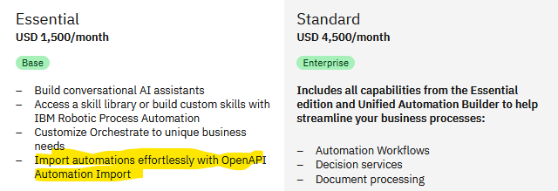
Why use BAMOE when WXO has its own Workflow and Decision Engine?
Customers may prefer open-source solutions
Essential edition does not come with CP4BA
Integrating Wxo with Open-source HOL

Slide 7

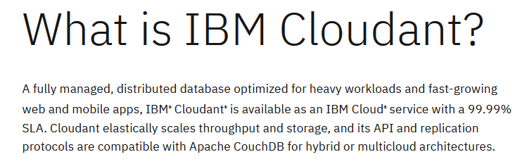
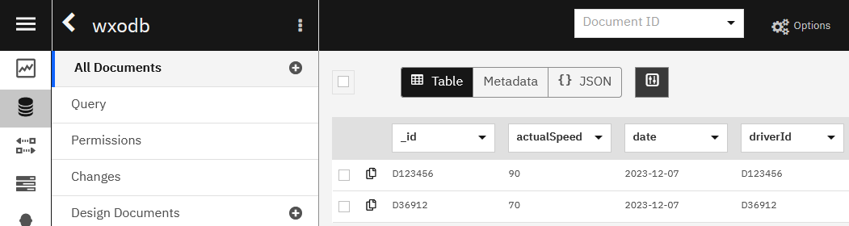
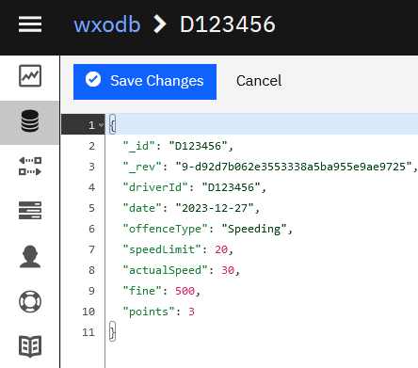
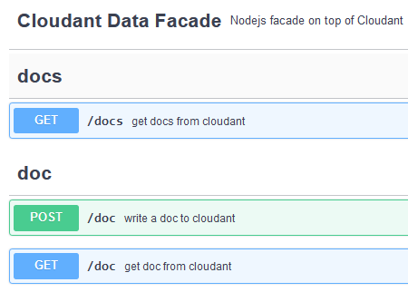
Cloudant is a non-relational, distributed database
Built on top of open source CouchDb
Cloudant stores Json, which is perfect for WXO
https://www.ibm.com/products/cloudant
Integrating Wxo with Open-source HOL

Slide 8
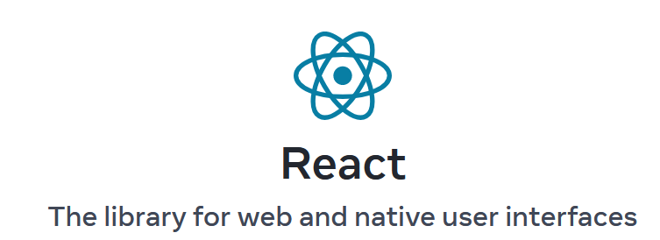
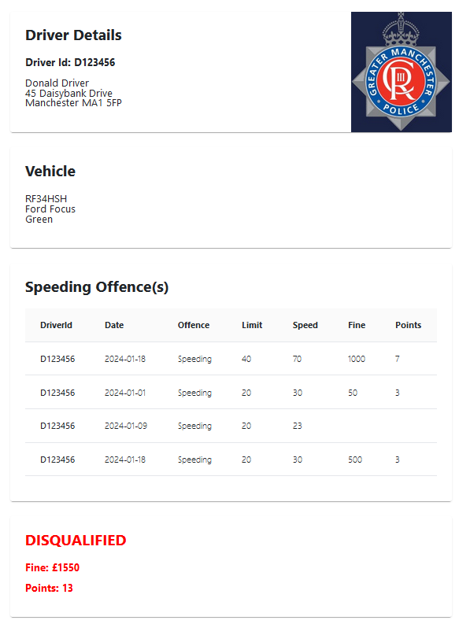
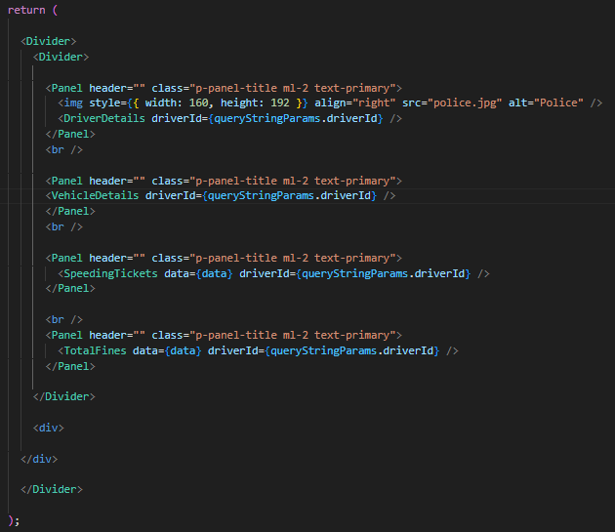
React is a free and open-source front-end JavaScript library for building user interfaces based on components.
For our case we use it to create speeding tickets
https://react.dev/
Integrating Wxo with Open-source HOL

Slide 9

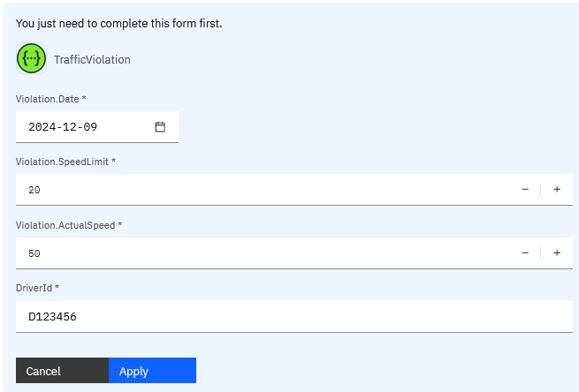
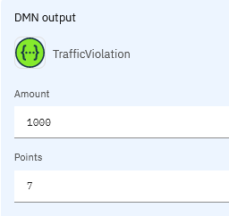
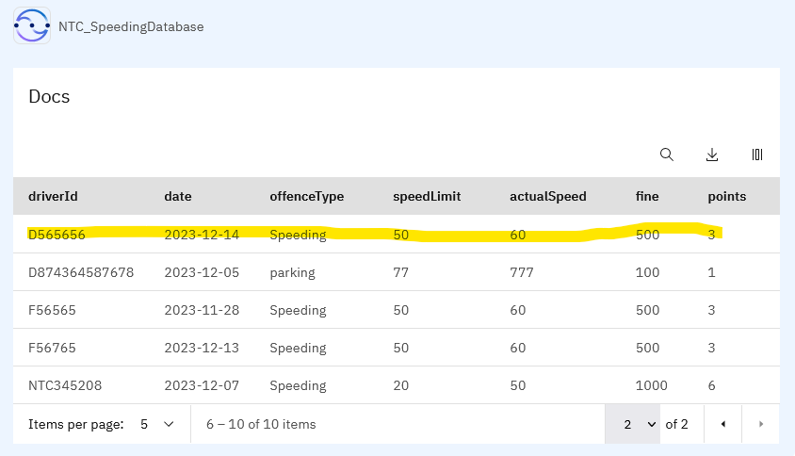
Use Case
Cop enters speeding
Ticket into Wxo using mobile device
Traffic cop stops a speeding driver
Speeding fine calculated and stored
Officer selects the tickets to issue
Ticket Issued
BAMOE calculates Penalty which is stored in Cloudant
Back in the HQ, policeman retrieves violations from Cloudant and selects tickets to be issued
Tickets generated using React
Integrating Wxo with Open-source HOL

Slide 10


Slide 11
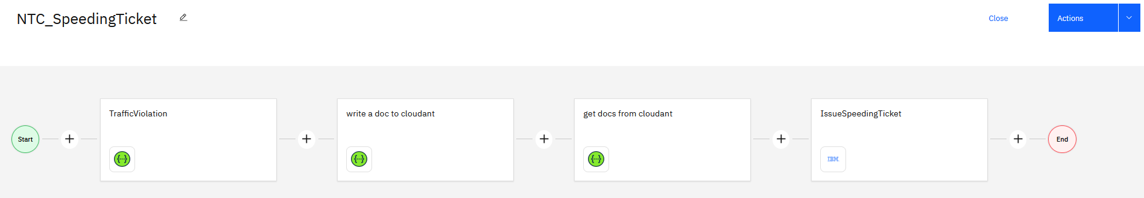
What you will do in the Lab
Create an OpenApi for BAMOE and Cloudant
Import these APIs into Wxo
Combine using a Wxo skill flow
Add a link to React Report
Run the skill flow
…
Watsonx Orchestrate Skill Flow
BAMOE
Cloudant
Cloudant
React

Slide 12

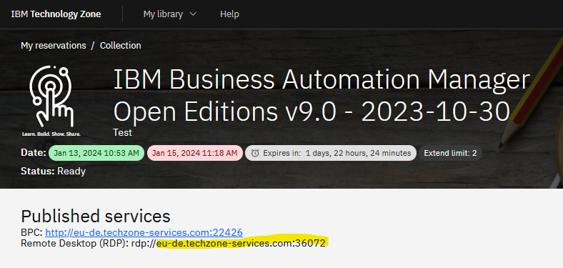
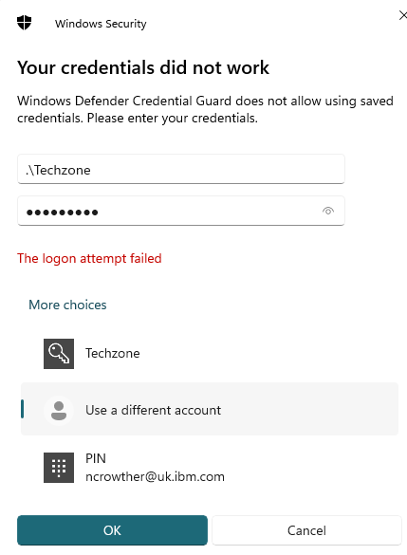
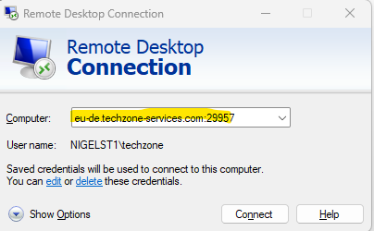
Let’s get started!
For those starting without VMS, start at section 3 and use
XXXSpeedingService and XXXCloudantFacade
User: .\Techzone
Password: IBMDem0s!
Integrating Wxo with Open-source HOL

